Slide 1
Angular CLI

Slide 2
Angular CLI
The Angular CLI is a command-line interface for Angular that helps us to get started with creating an Angular application.
Angular CLI creates an Angular application and uses the Typescript programming language, Webpack for Module bundling, Karma for unit testing, and Protractor for end-to-end testing.
The Angular CLI takes care of the configuration and initialization of various libraries.
It also allows us to add components, directives, services, etc, to already existing Angular applications.

Slide 3
Installing Angular CLI
Before installing Angular CLI, make sure the development environment includes Node.js and an npm package manager.
Run the command npm install -g @angular/cli on the terminal to install the Angular CLI using npm.
Run the CLI command ng new my-app to create a new angular app with the my-app name.
The Angular CLI includes a server so that we can easily build and serve your app locally.
First, go to the my-app workspace folder and Launch the server by using the CLI command ng serve --open.

Slide 4
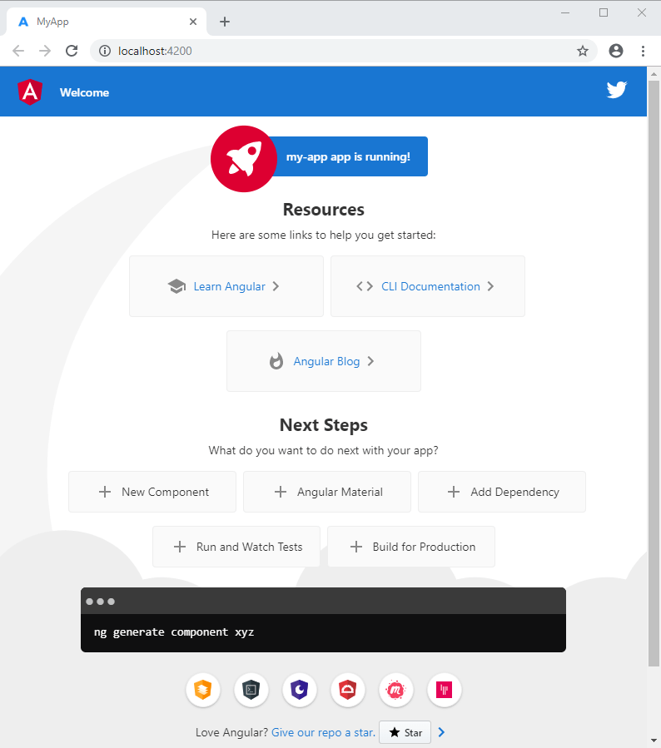
Installing Angular CLI
The ng serve command launches the server on HTTP port 4200, which watches our files and rebuilds the app as we make changes to those files.
The --open (or just -o) option automatically opens the browser to http://localhost:4200.

Slide 5
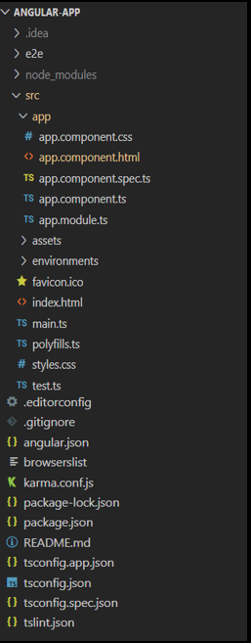
Angular File Structure

Slide 6
Angular File Structure
The e2e folder at the top level contains source files for a set of end-to-end tests and test-specific configuration files.
The node_modules folder provides npm packages to the entire workspace.
The src folder contains the source files which give information about application logic, data, and assets.

Slide 7
Angular File Structure
app - this folder contains the component files.
app.component.ts - used to define the logic for the app's root component (AppComponent).
app.component.html - used to define the HTML template associated with the root AppComponent.
app.component.css - used to define the base CSS stylesheet for the root AppComponent.
app.component.spec.ts - used to define the unit test for the root AppComponent.
app.module.ts - used to define the root module (AppModule) and helps the Angular to assemble the application. All components, including the AppComponent, must be declared inside the AppModule.

Slide 8
Angular File Structure
assets - this folder contains image and other asset files.
environments - this folder contains build configuration options for particular target environments.
favicon.ico - An icon to used for an application in the bookmark bar.
index.html - The main HTML page that is served when someone visits your site. The CLI automatically adds all JavaScript and CSS files when building your app, so you typically don't need to add any <script> or <link> tags here manually.
main.ts - The main entry point for an application. Compiles the application with the JIT compiler and bootstraps the application's root module (AppModule) to run in the browser.

Slide 9
Angular File Structure
polyfills.ts - Provides polyfill scripts for browser support.
styles.css - Lists CSS files that applies the styles for a project.
test.ts - The main entry point for unit tests used in the application.
.editorconfig - this file contains configuration for code editors.
.gitignore - it specifies untracked files that Git should ignore.
angular.json - holds CLI configuration defaults for all projects in the workspace. It includes configuration options for the build, serve, and test tools.
browserslist - used to configure the sharing of target browsers and Node.js versions among various front-end tools.

Slide 10
Angular File Structure
karma.conf.js - it contains application-specific Karma configuration.
package-lock.json - this provides version information for all packages installed into node_modules by the npm client.
package.json - used to configure npm package dependencies that are available to all projects in the workspace.
README.md - An introductory documentation for the root app.
tsconfig.app.json - it holds application-specific TypeScript configuration, including TypeScript and Angular template compiler options.
tsconfig.json - holds default TypeScript configuration for projects in the workspace.
tslint.json - holds default TSLint configuration for projects in the workspace. TSLint is an extensible static analysis tool that checks TypeScript code for readability, maintainability, and functionality errors.

